Slide 1
Overview of Decedent’s Final
Individual Income Tax Return
Christine G. Pronek, CPA, MST
Partner, Trusts and Estates
cpronek@odpkf.com
May 16, 2014
Notes:
Describe our combination and the benefits

Slide 2
Final Form 1040
Filing Status
Due Date
Form 1310, “Statement of Person Claiming Refund Due a Deceased Taxpayer”
Signing and Mailing
Request for Prompt Assessment of Decedent’s Income Taxes (Form 4810)

Slide 3
Allocation of Income and Expenses
Cash Basis
Income allocated based on income actually or constructively received before DOD
Deductions taken for expenses actually or constructively paid before DOD

Slide 4
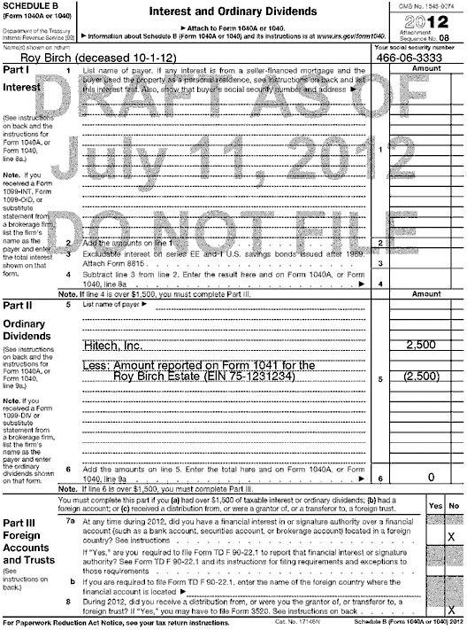
Allocation of Income and Expenses (cont’d)
Reporting of Form 1099 Information
Report total amount on Form 1099 and “back out”/”nominee” portion to be included on the income tax return of Estate/beneficiary.

Slide 5
Allocation of Income and Expenses (cont’d)
Assets Held Jointly or POD (payable on death)
Income received after DOD is reported by person receiving assets regardless of when the asset is actually transferred.
Report total amount on Form 1099 and “back out/”nominee” portion to be included on income tax return of beneficiary including name and social security number of the beneficiary.

Slide 6
Tax Attributes of Final Form 1040
Carryovers – expire in year of death
Charitable contribution carryover; investment interest carryover; capital loss carryover; minimum tax credit carryover; unused NOL carryover
Exceptions
NOL generated in final year of 1040
Business credit carryover
Foreign tax credit carryover
Unused PALs at time of death

Slide 7
Tax Attributes of Final Form 1040 (cont’d)
Tax Credits
Earned income tax credit; child tax credit; adoption credit
May be allowable on Final Form 1040

Slide 8
Tax Attributes of Final Form 1040 (cont’d)
Exclusion of Gain on Sale of Residence
Decedent’s period of ownership and use carryover to SS as long SS not remarried at time of the sale
SS may use $500,000 exclusion provided:
  Sale is within two years of the date of death
  SS is not remarried at time of sale
  Other requirements for gain exclusion are met

Slide 9
Elections
Medical Expenses
Election can be made to treat expenses paid within one year after DOD as if paid by the decedent and therefore claimed on Final Form 1040
  Election made by attaching statement (in duplicate) with the Final Form 1040 or on an amended return.

Slide 10
Elections (cont’d)
Waiver of Right To Deduct Medical Expenses On Decedent’s
Estate Tax Return

Slide 11
Elections (cont’d)
US Savings Bond Interest
(Section 454 Election)
All interest accrued from acquisition date through DOD on Series E and EE bonds can be included on decedent’s Final Form 1040 via election made on a timely filed return (including extensions)

Slide 12
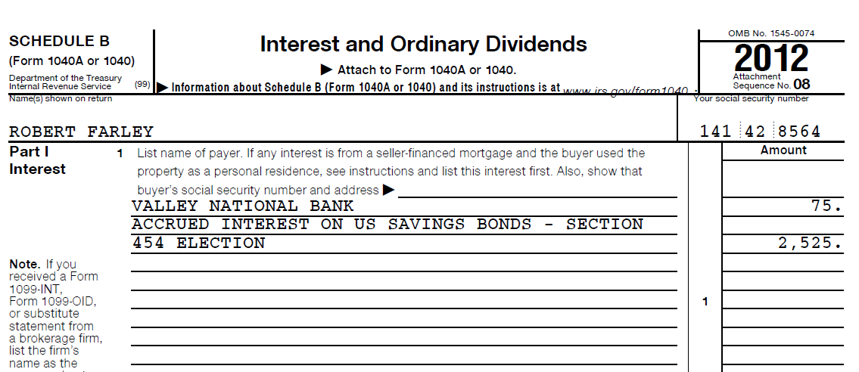
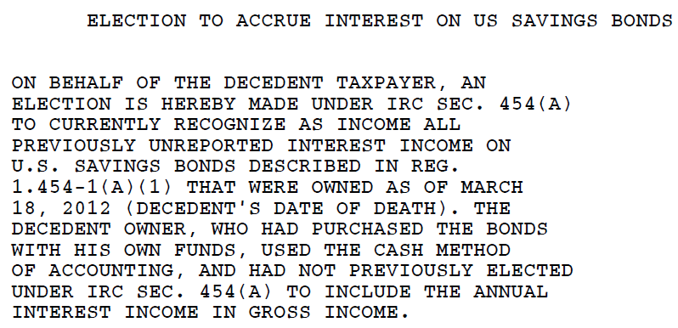
Elections (cont’d)

Slide 13
Other Issues
Decedent’s IRA/401k
  Rollover options
  MRD for year of death
  Federal estate tax deduction
Beneficiary changes
Unclaimed Property (www.missingmoney.com)

Slide 14

Q&A

